Slide 1
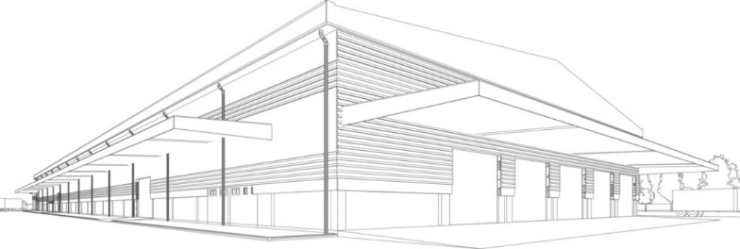


Sri Murugan Complex, 2nd Floor,
No:220/1a, Thiruvallur High Road,
Kancheepuram District,
Sriperumbudur Taluk,
Sunguvarchatram - 602106 Tamil Nadu
e.mail : admin@sssconstruction.co.in
e.mail : s.sssconstruction@yahoo.com
Contact : 9750 - 141429
an Complete ENGINEERING Solution

Slide 2
about us
SSS CONSTRUCTION is Established in the year 2010 in Sunguvarchatram area. We are participate the Civil and Allied works and services that include Industrial Buildings, Road & Trench works, Boundary walls, Residential and Commercial Buildings, MS Structural Fabrication works, Interior & Painting works and others construction related works as per the requirement of our clients.
A piece of land, four walls built around it & a roof on top can make a house, but we at SSS Construction of experience, strength of quality construction, colors of innovative solutions, lights of new technology, surety of transparent transactions & finally the touch of emotion that converts it in to your dream project which adds status to you. In this age of technology where the world has become very small, companies today need to provide quality, efficient, innovative, new age & cost effective solutions to cater the ever evolving customers, and construction industry is no exception to it.
SSS Construction stands tall when it comes to deliver the above attributes. We have an approach where we work for utmost customer satisfaction & thus we have been able to create our niche in the market as one of the construction companies. Our projects at different locations and different factories and we assure to our customers a perfect living solution with continuing our journey of building status.

Slide 3
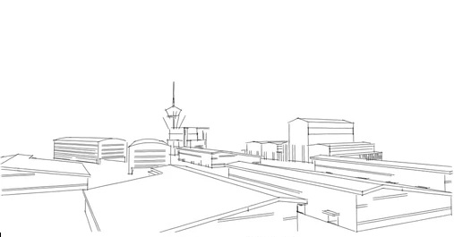
Company Vision
To become the leading construction firm, while delivering projects that consistently exceed international standards and provide exceptional customer satisfaction.
To continually deliver excellent value & innovative construction solutions to meet our clients' requirements.
Using modern principles and sophisticated technologies, our Company envisions being the primary preference at all times both nationally and globally, for their renowned excellence, quality, performance and reliability in all types of constructions.

Slide 4








Our Precious Clients
Madras Engineering Industries Pvt. Ltd.

Slide 5
Some of Our Completed Projects

Slide 6
Some of Our Completed Projects
Purchase Order For Material Cost.

Slide 7
Some of Our Completed Projects
Client : Nippon Paint (India) Pvt. Ltd.
Project : Factory Compound wall
Year : 2017
Value : 48.07 Lakh [INR]
Purchase Order for Labour Cost.

Slide 8
Some of Our Completed Projects
Client : Madras Engineering industries Pvt. Ltd.[Pillaipakkam]
Project : Factory Compound wall
Year : 2018
Value : 11.84 Lakh [INR]
Year : 2018
Value : 18.89 Lakh [INR]
Year : 2018
Value : 29.73 Lakh [INR]

Slide 9
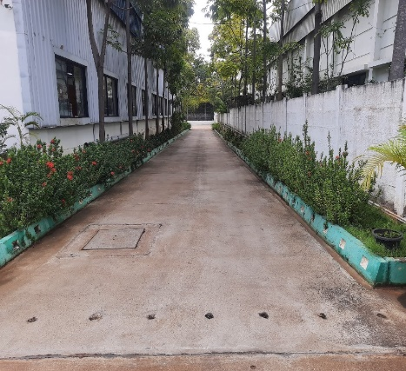
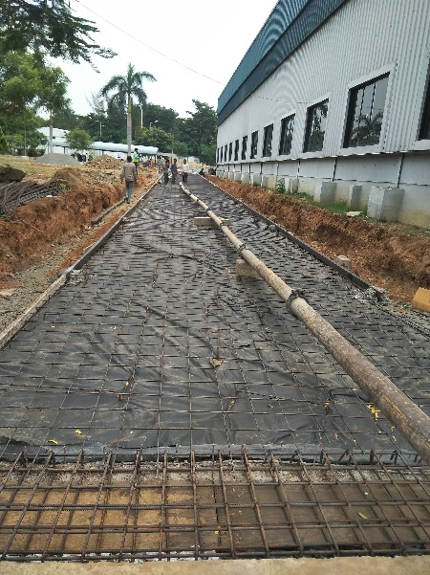
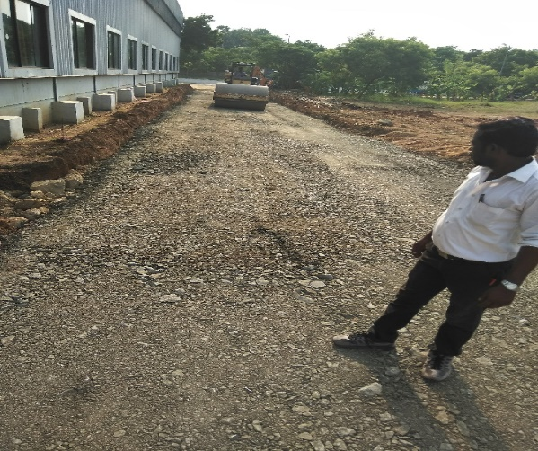
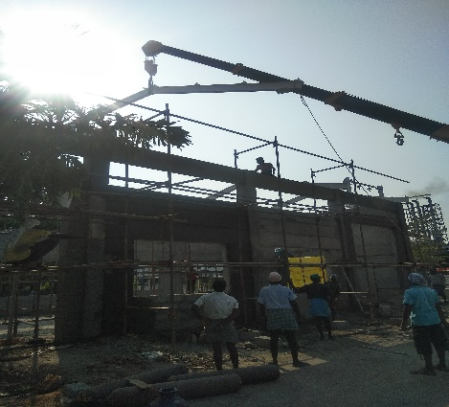
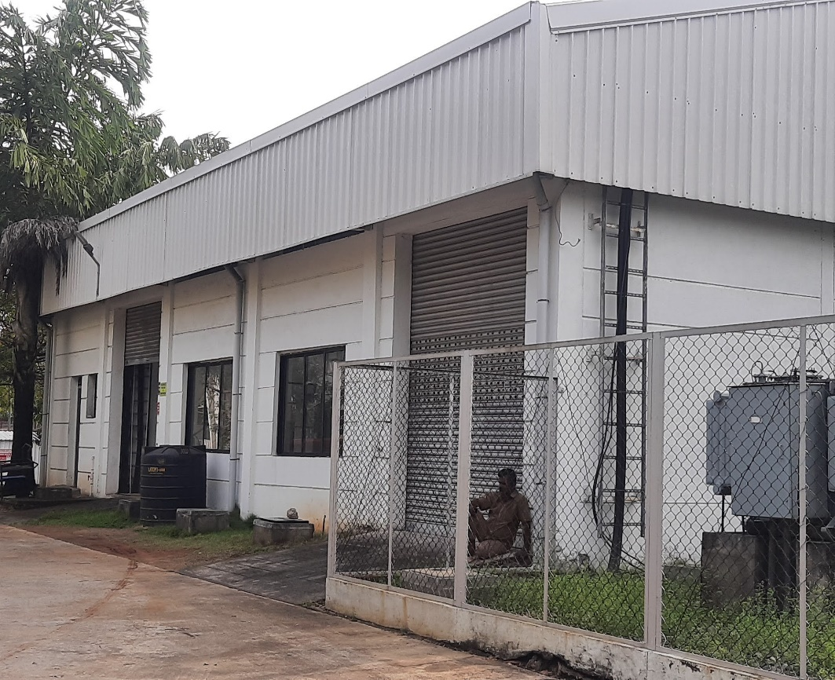
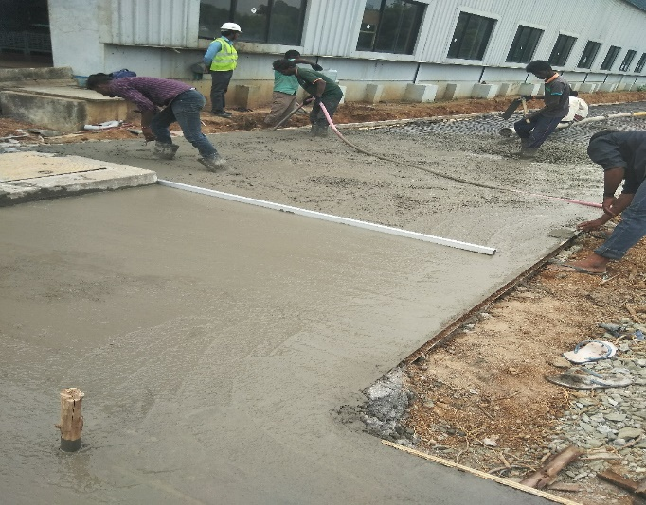
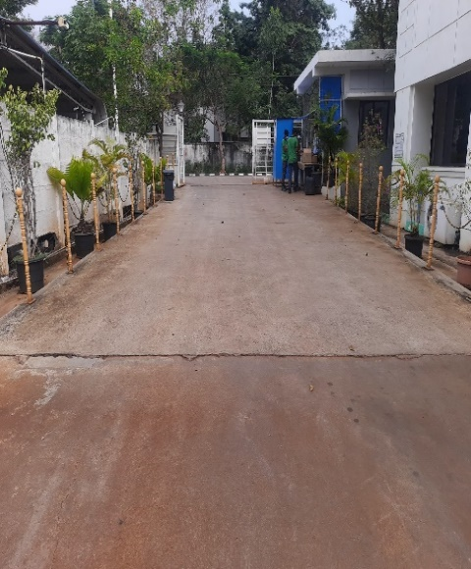
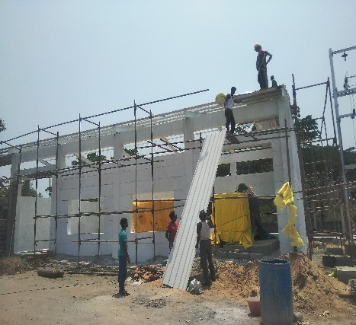
Some of Our Completed Projects
Client : Madras Engineering industries Pvt. Ltd.[M.City]
Project : Ramp, Road & Panel Room
Year : 2017
Value : 90 Lakh [INR]

Slide 10
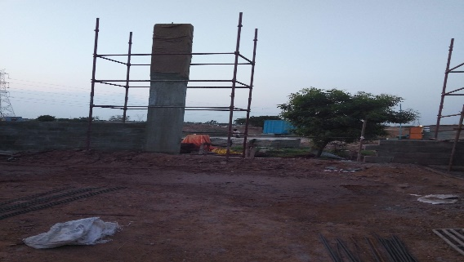
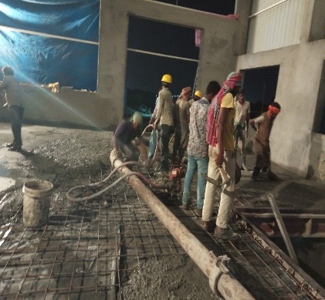
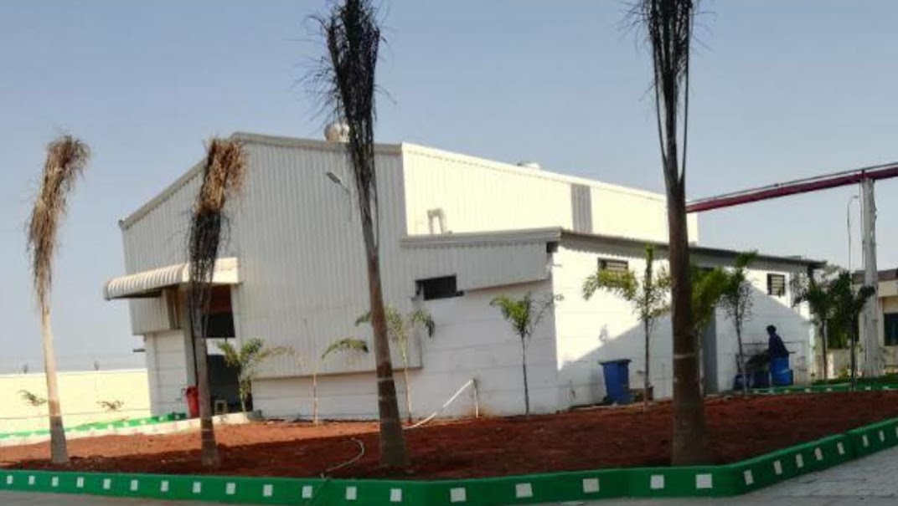
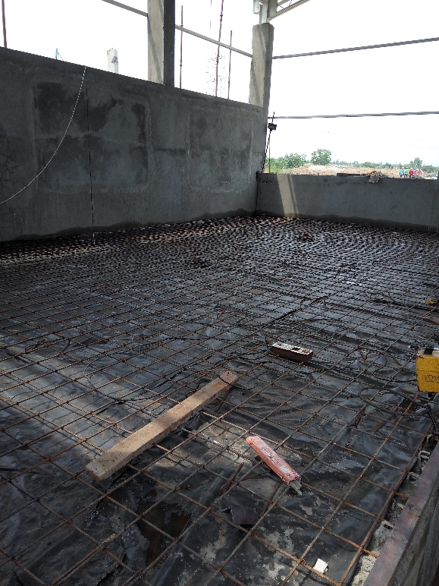
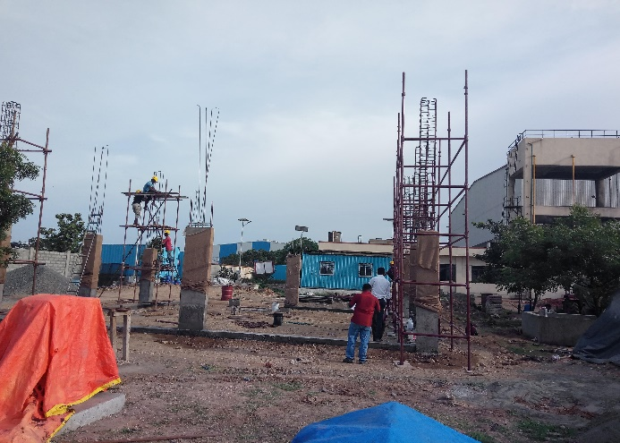
Some of Our Completed Projects
Client : Madras Engineering industries Pvt. Ltd.[Pillaipakkam]
Project : Unit-2 [Machine Shop] Toilet & Panel Room
Year : 2018
Value : 63 Lakh [INR]

Slide 11
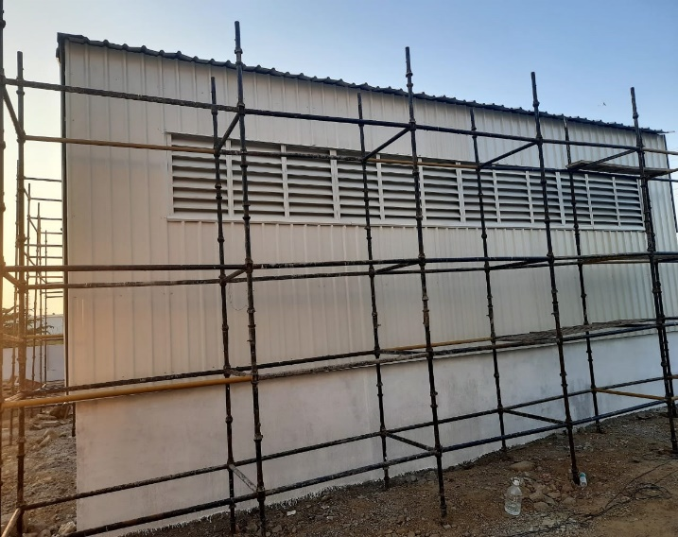
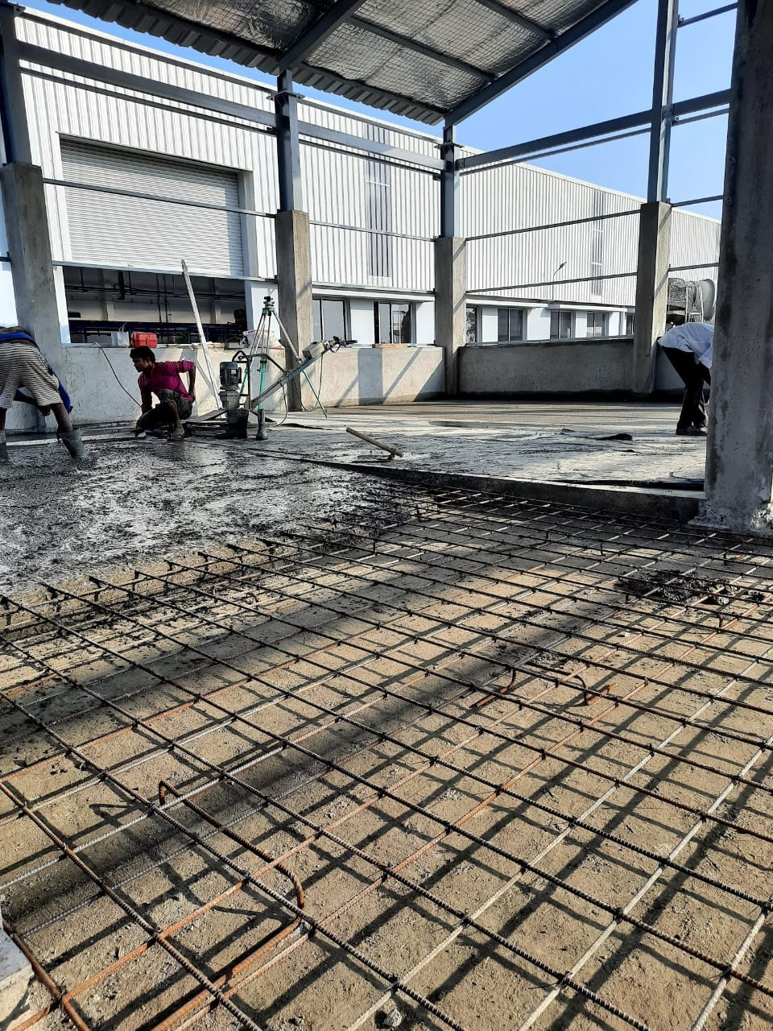
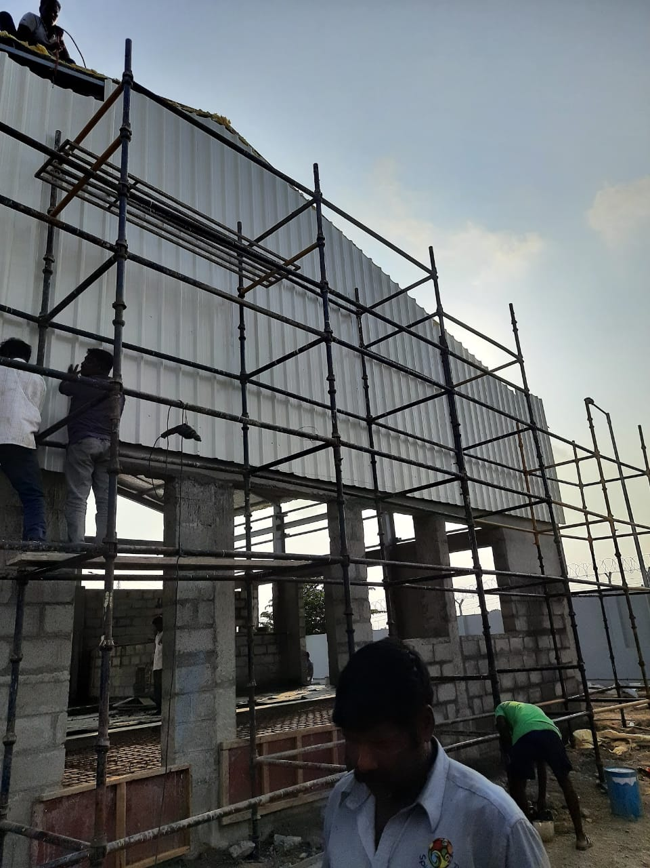
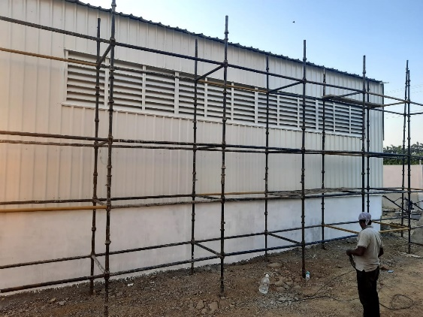
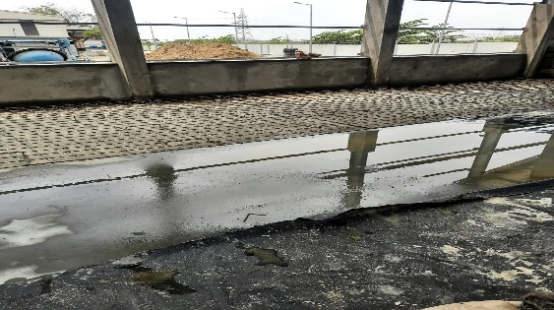
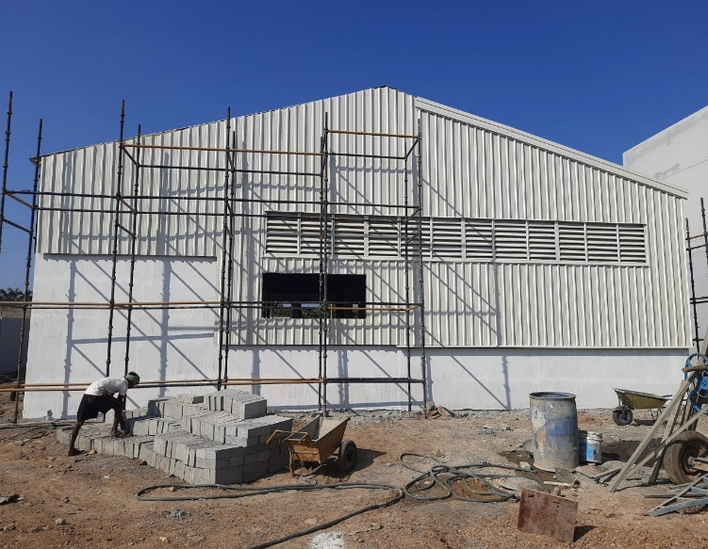
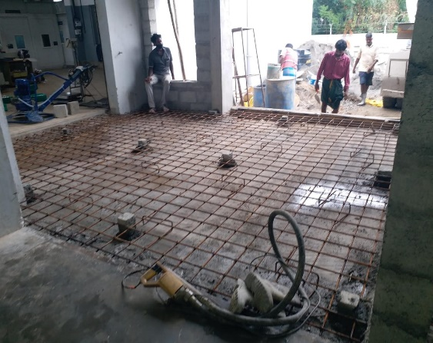
Some of Our Completed Projects
Client : A.P.Tools [irungattukottai]
Project : Assembly Shop
Year : 2019
Value : 51 Lakh [INR]

Slide 12
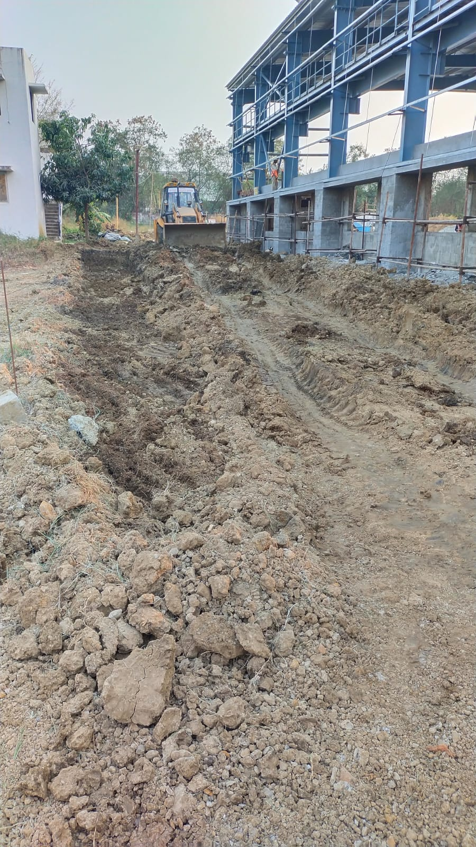
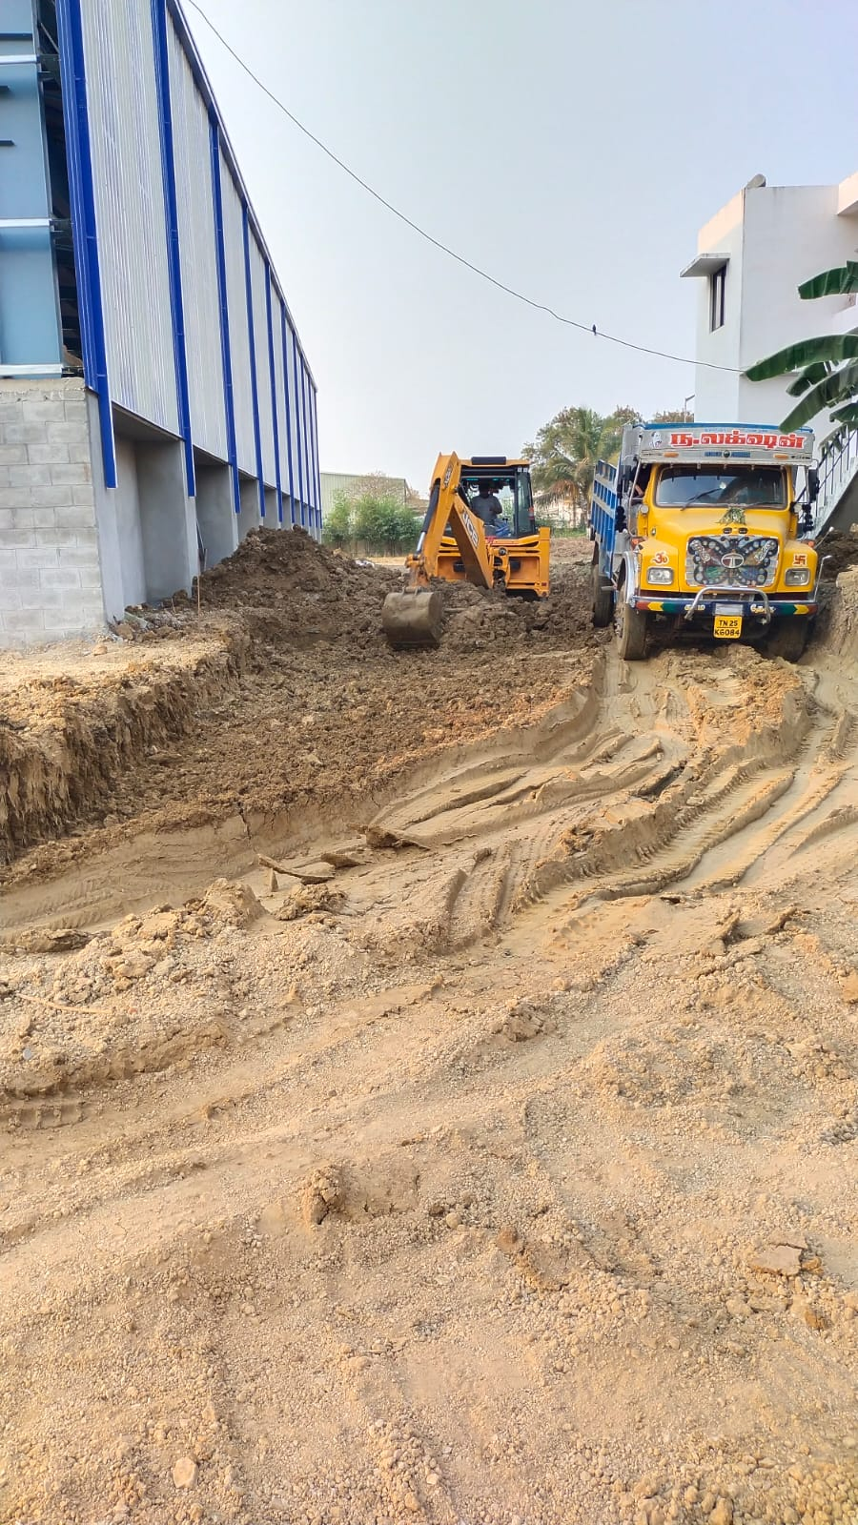
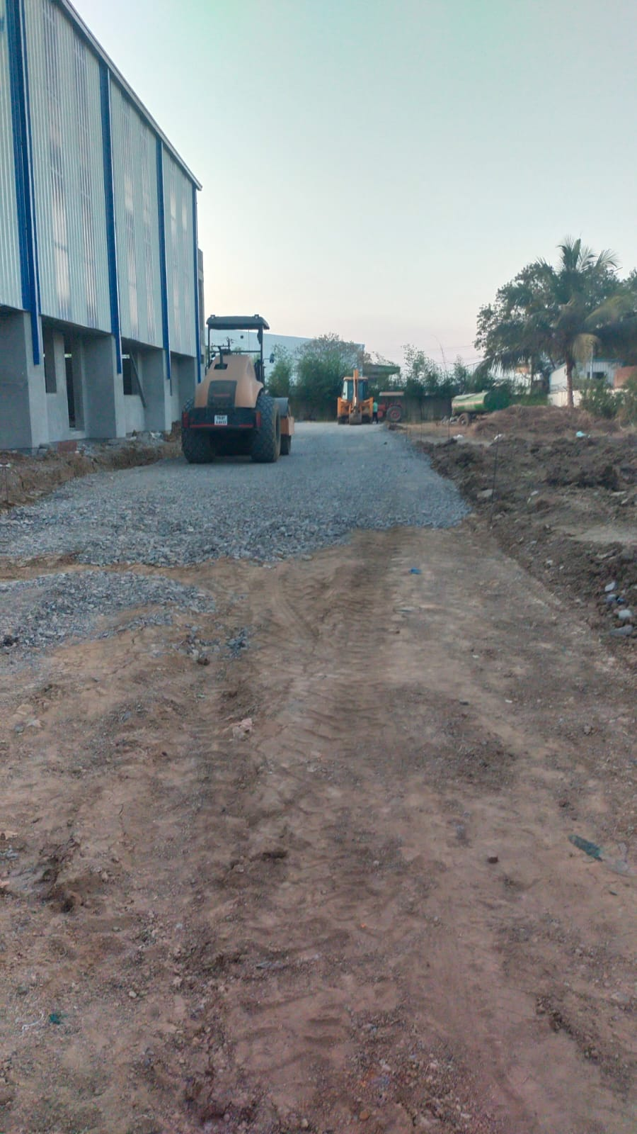
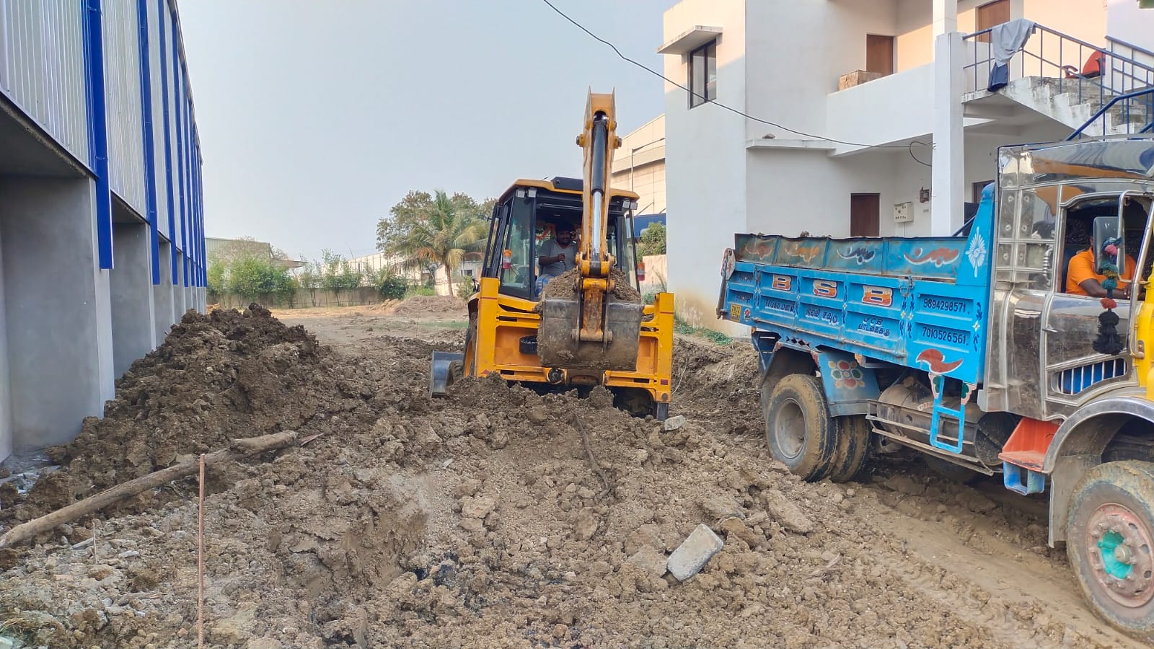
Some of Our Completed Projects

Slide 13
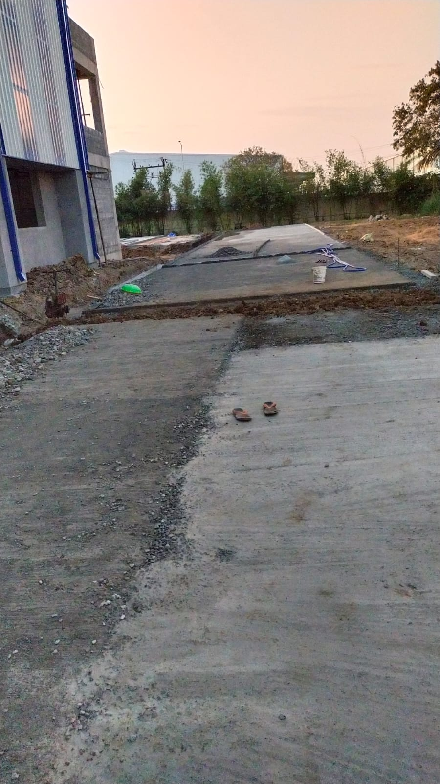
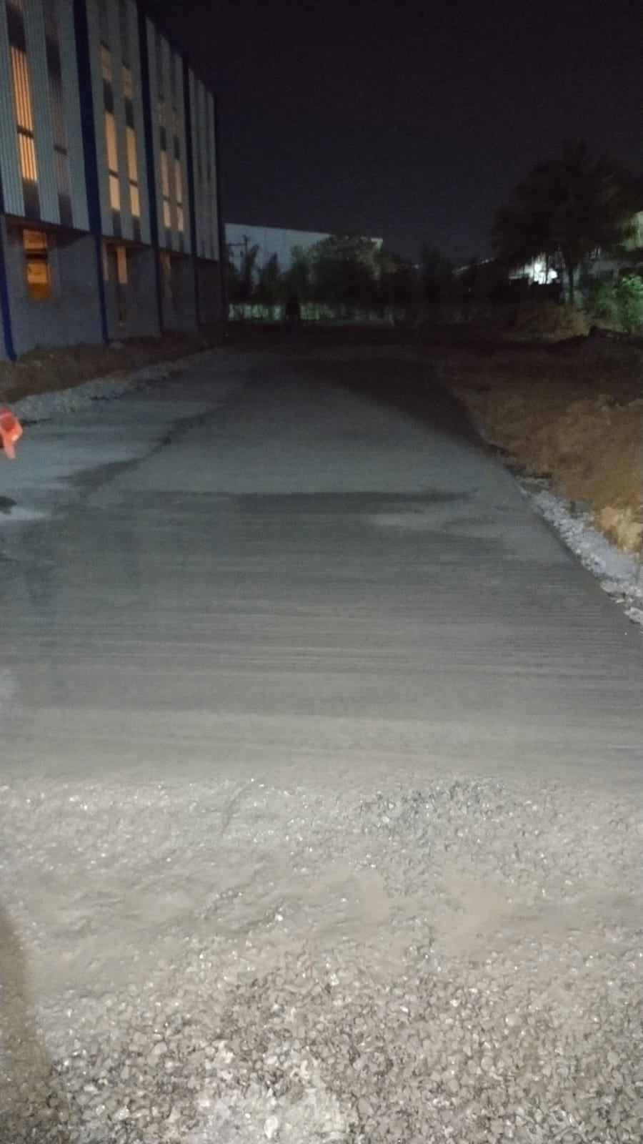
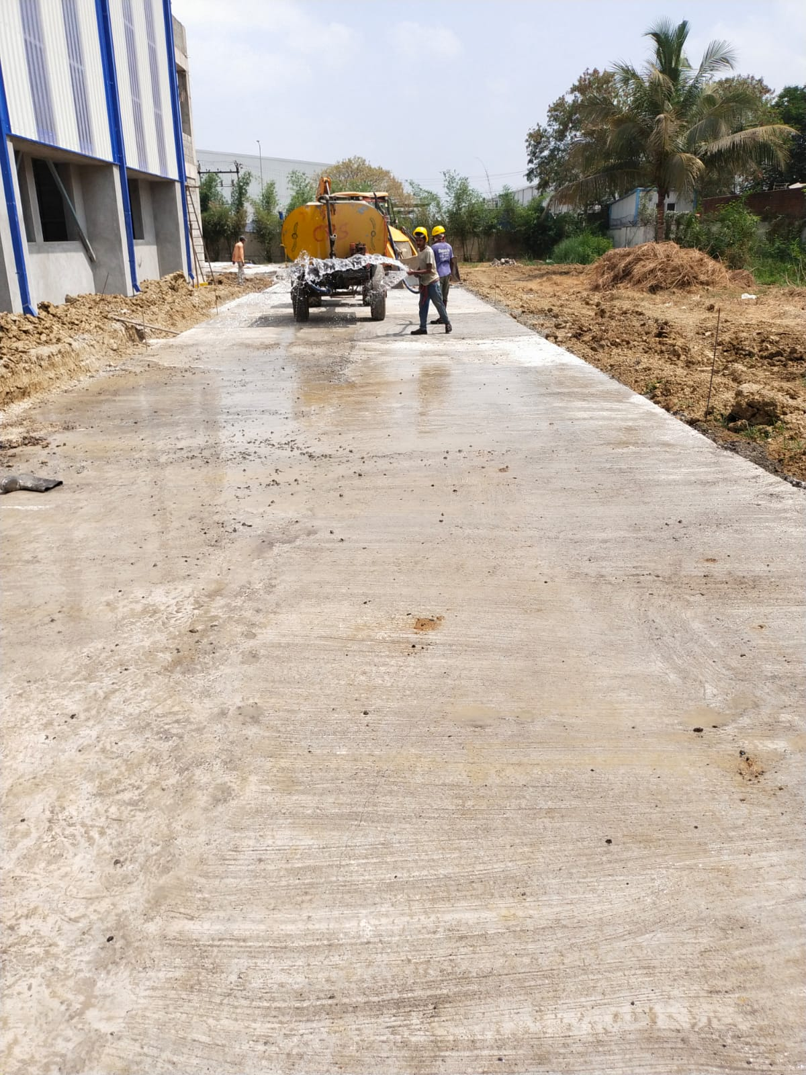
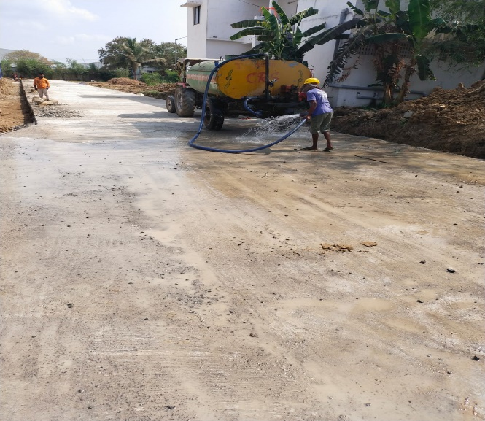
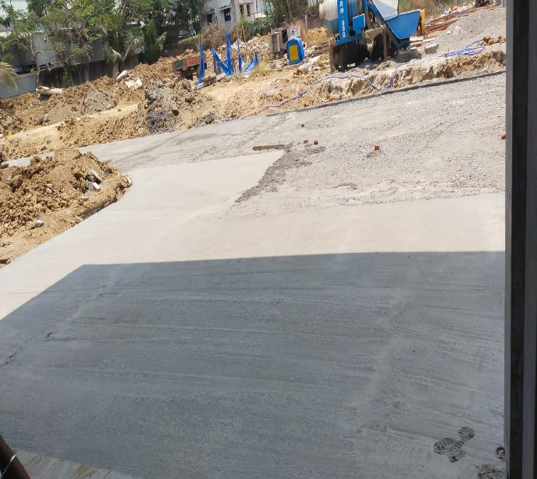
Some of Our Completed Projects

Slide 14
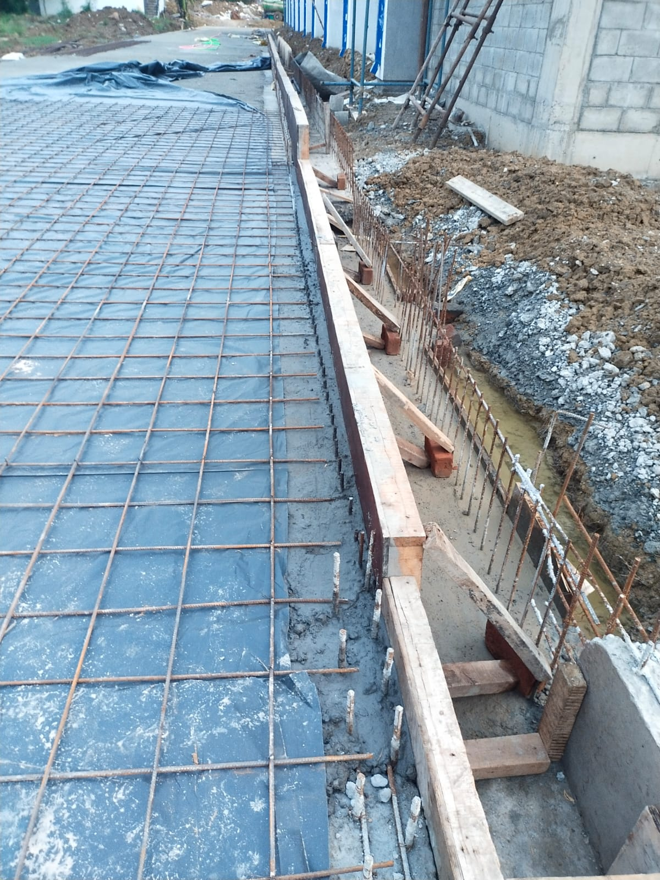
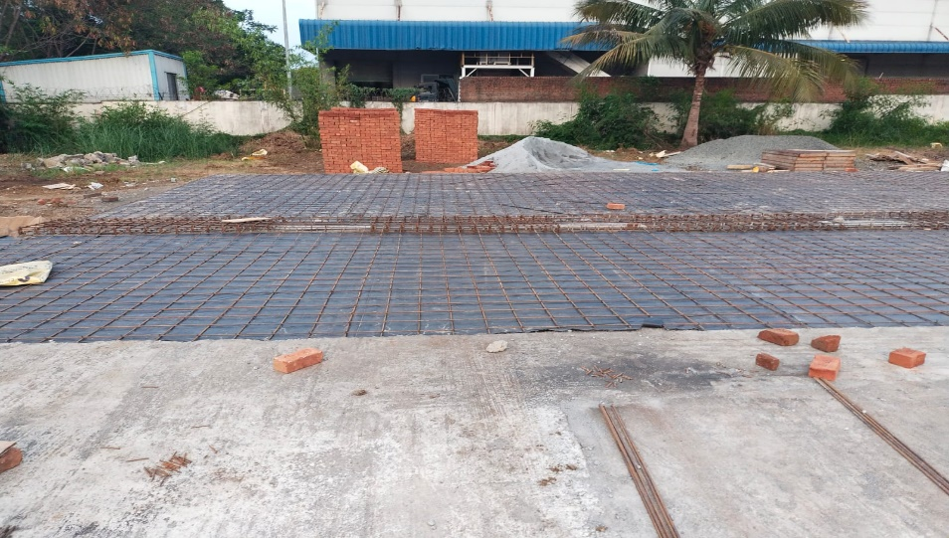
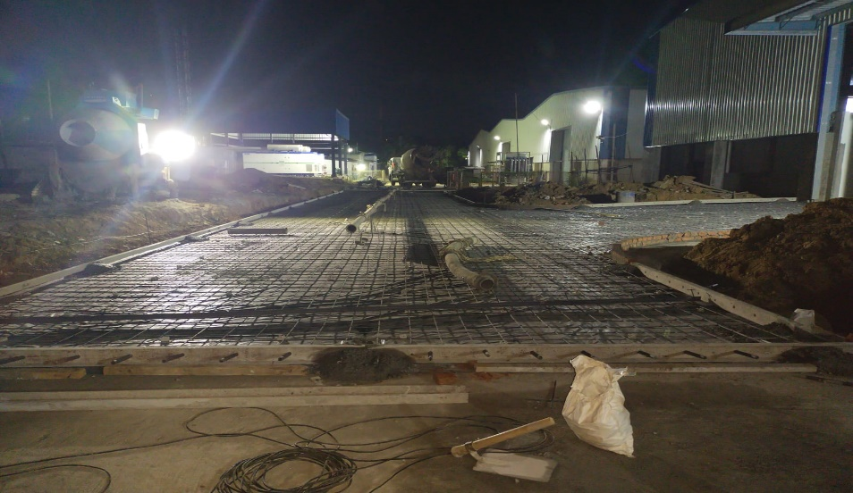
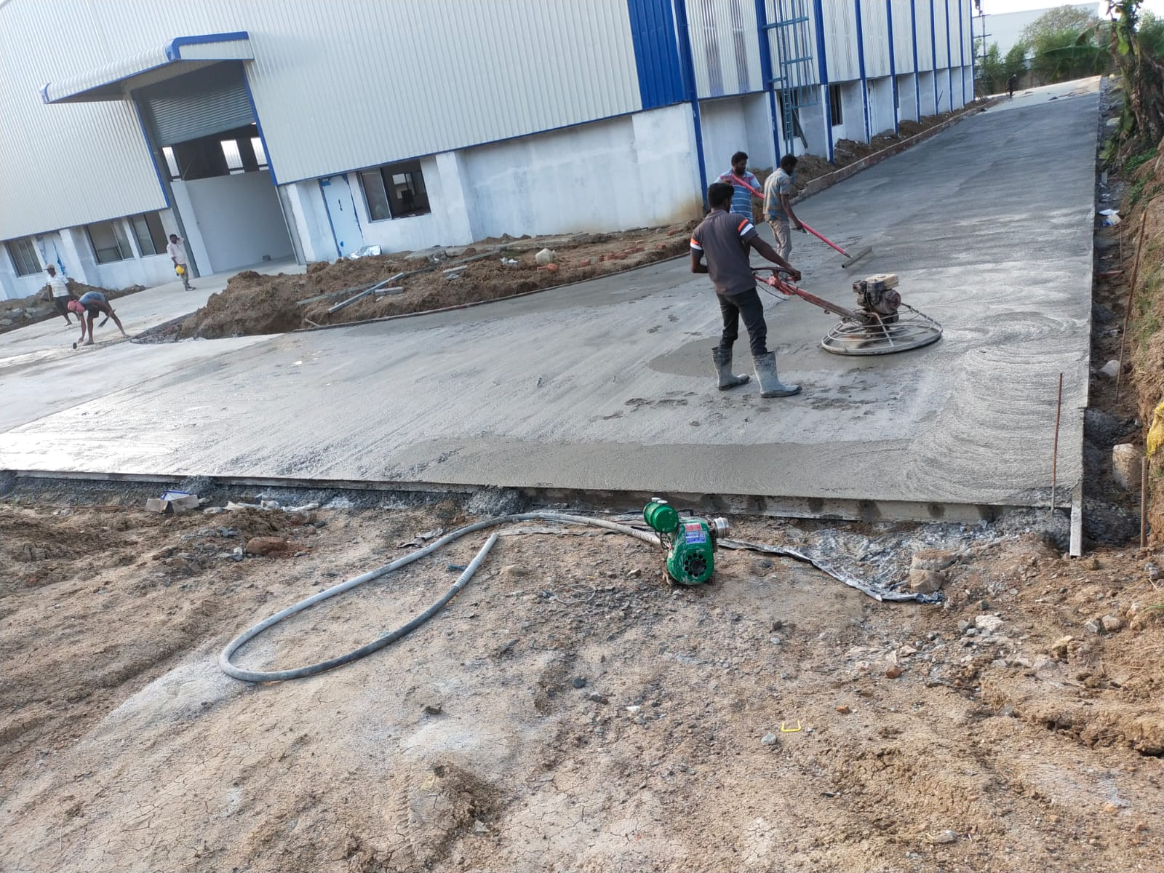
Some of Our Completed Projects

Slide 15
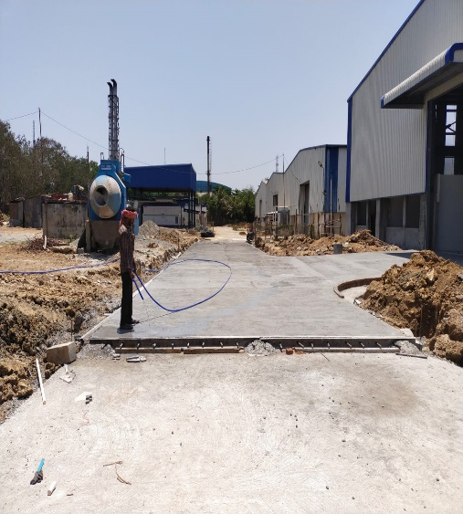
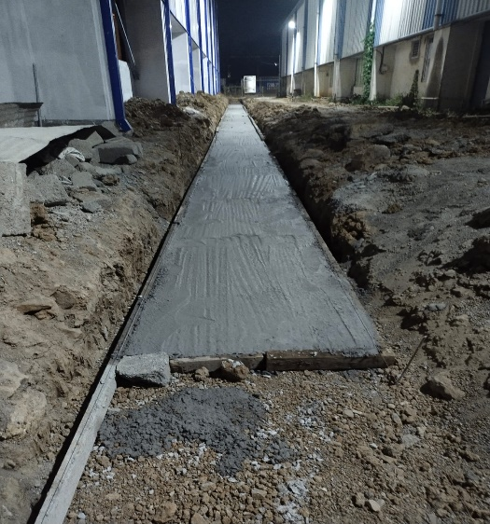
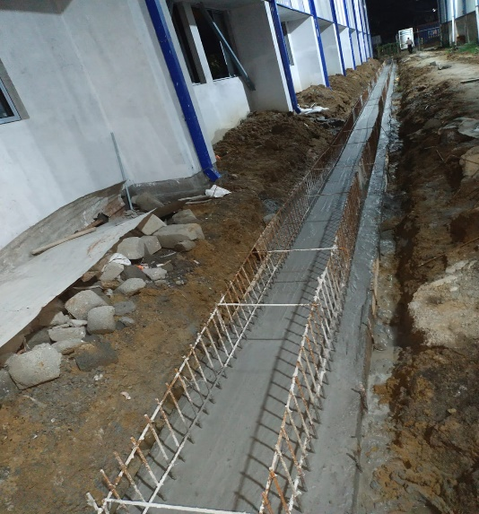
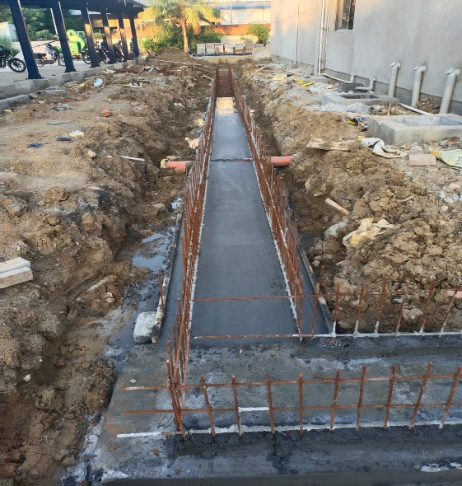
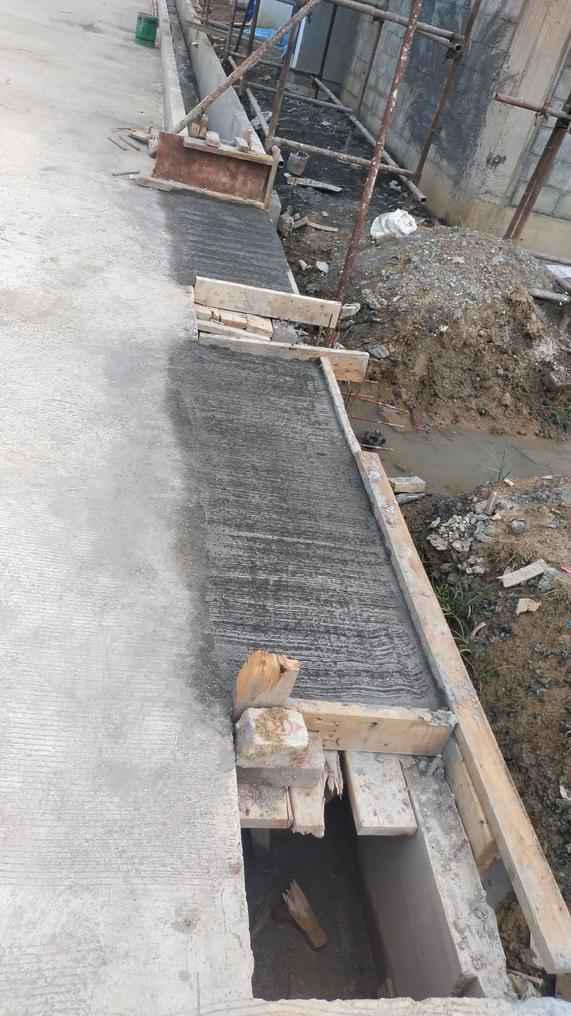
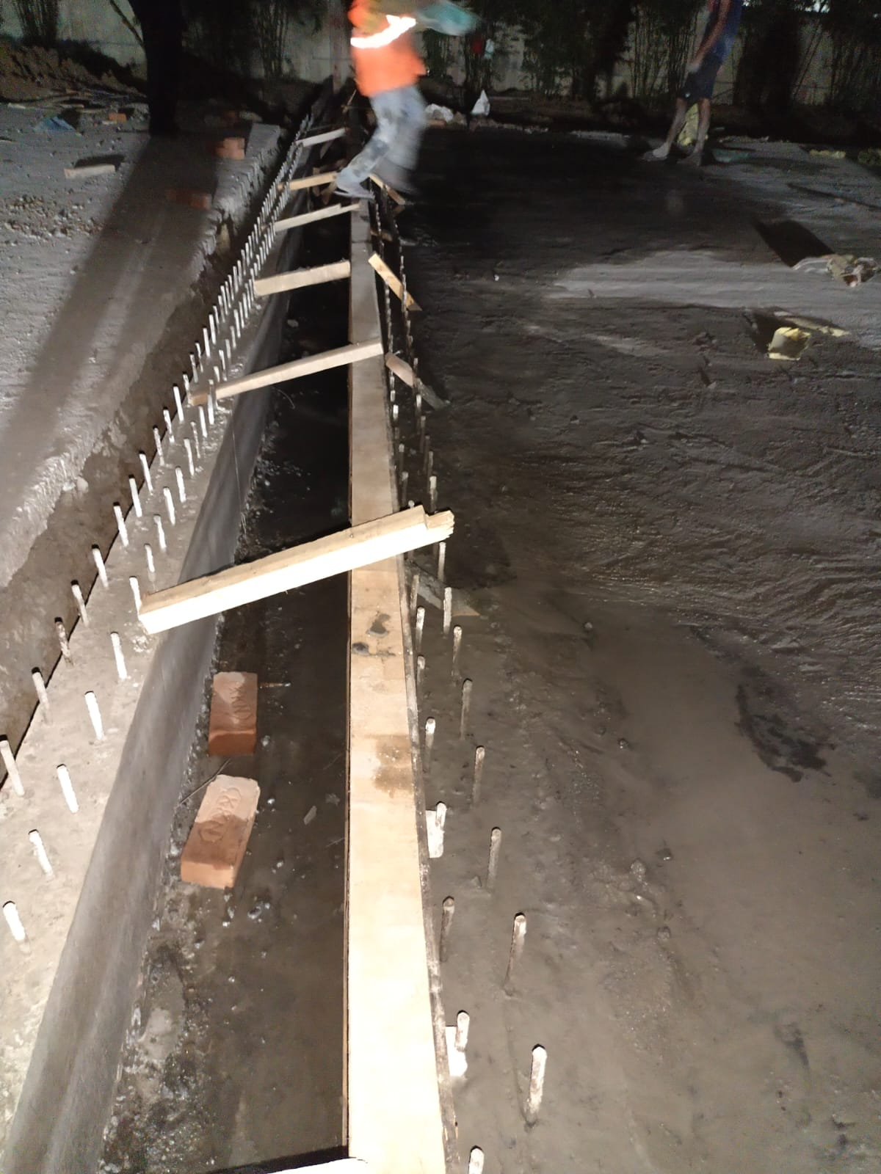
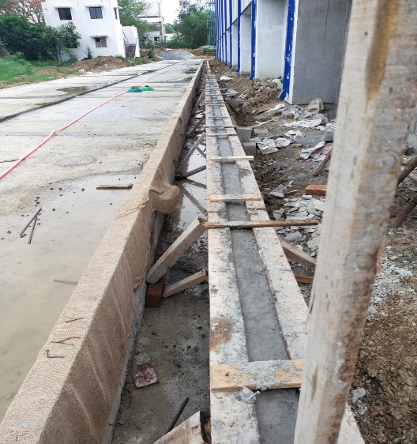
Some of Our Completed Projects

Slide 16
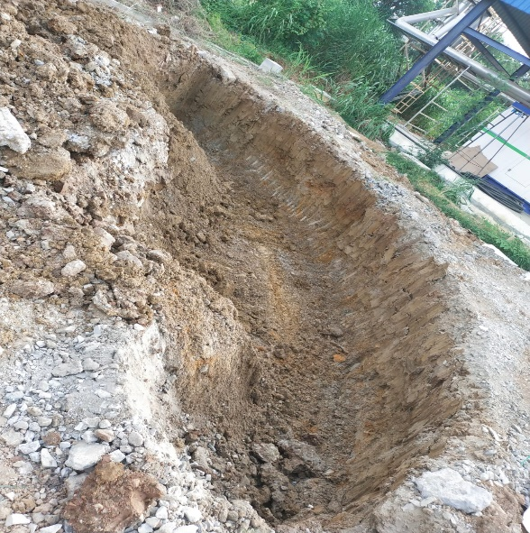
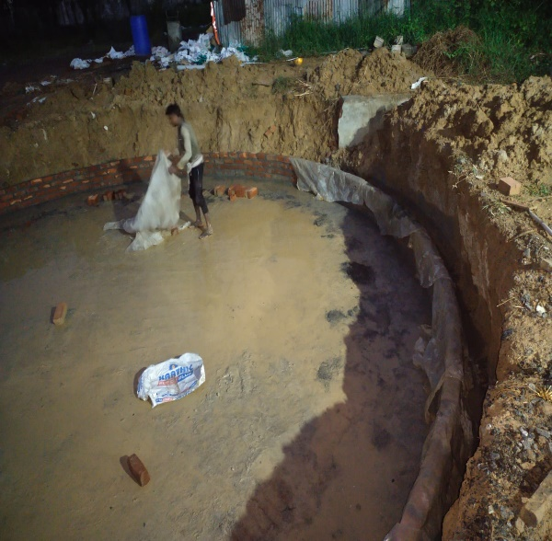
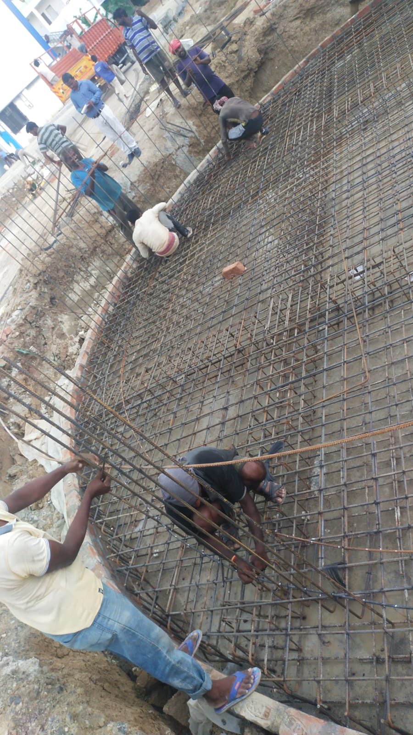
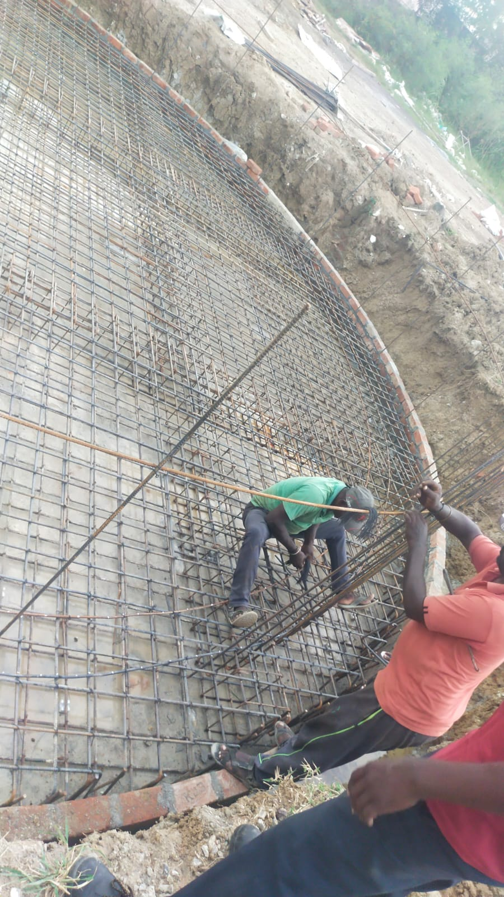
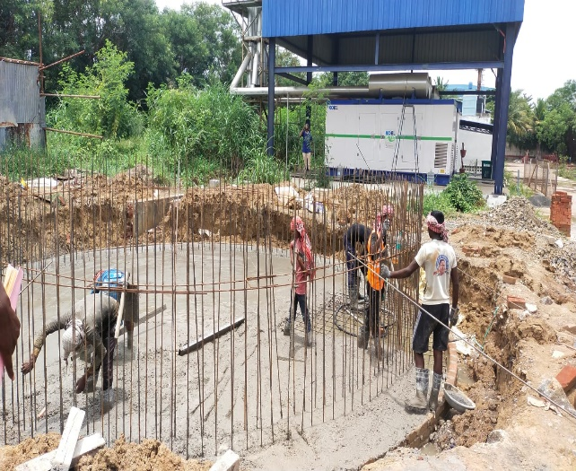
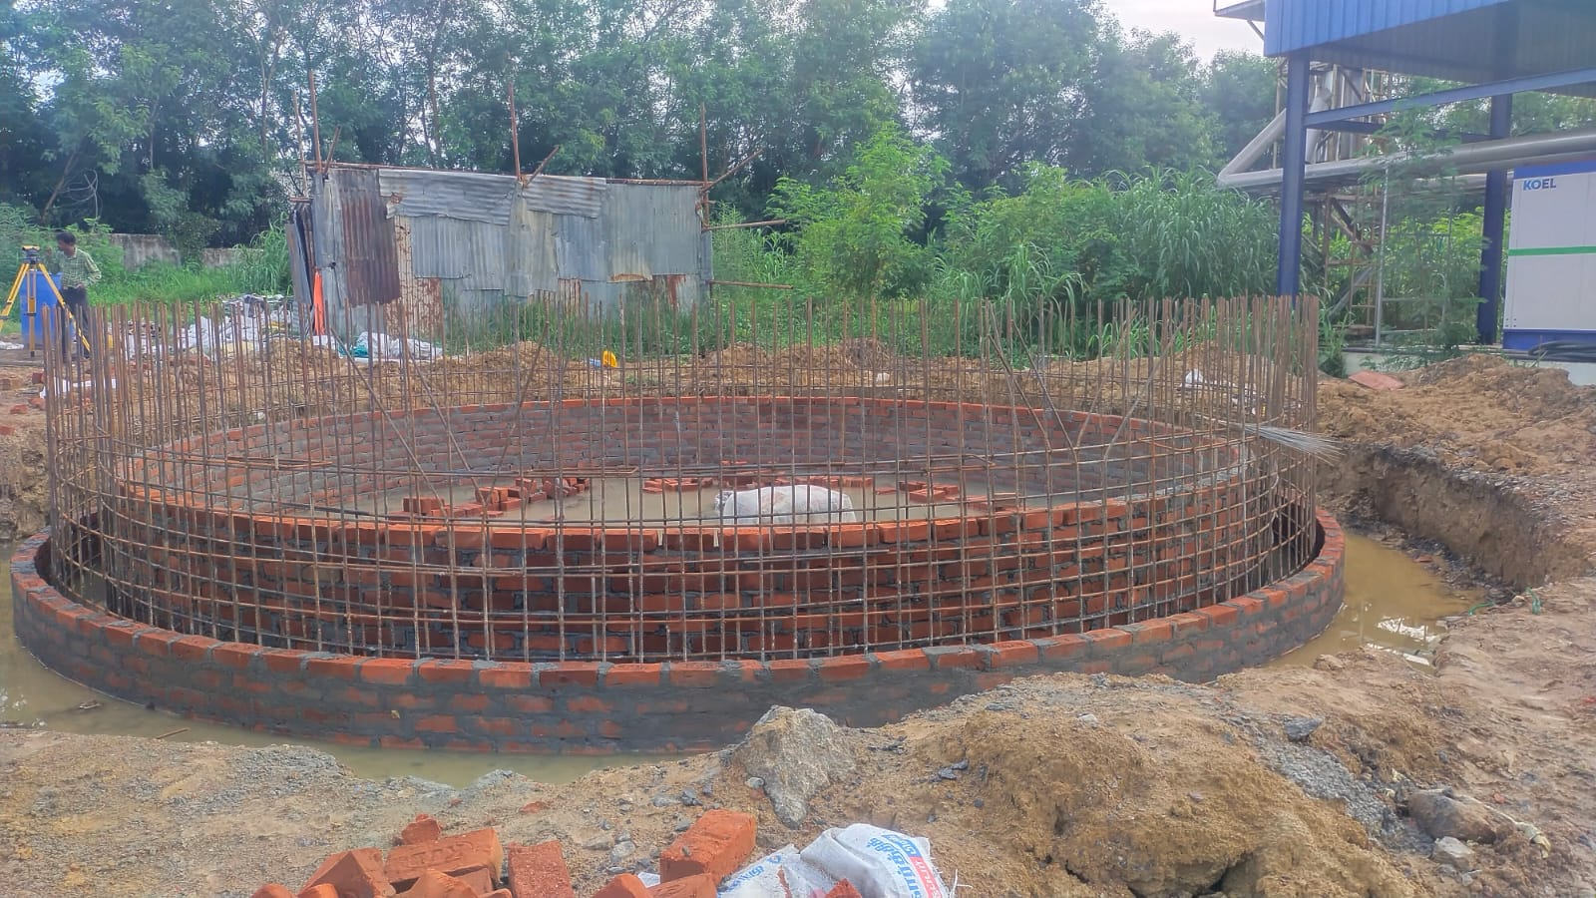
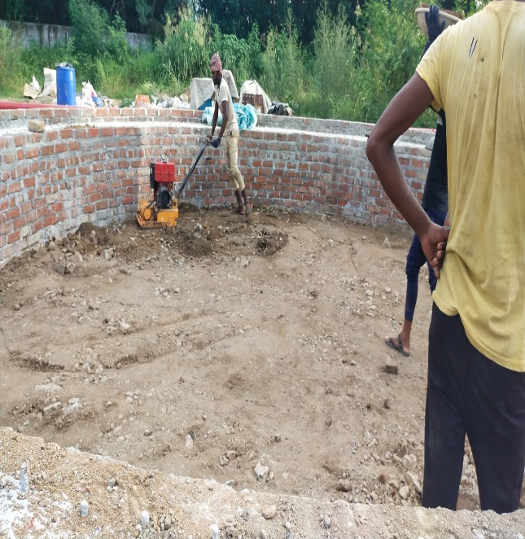
Some of Our Completed Projects

Slide 17
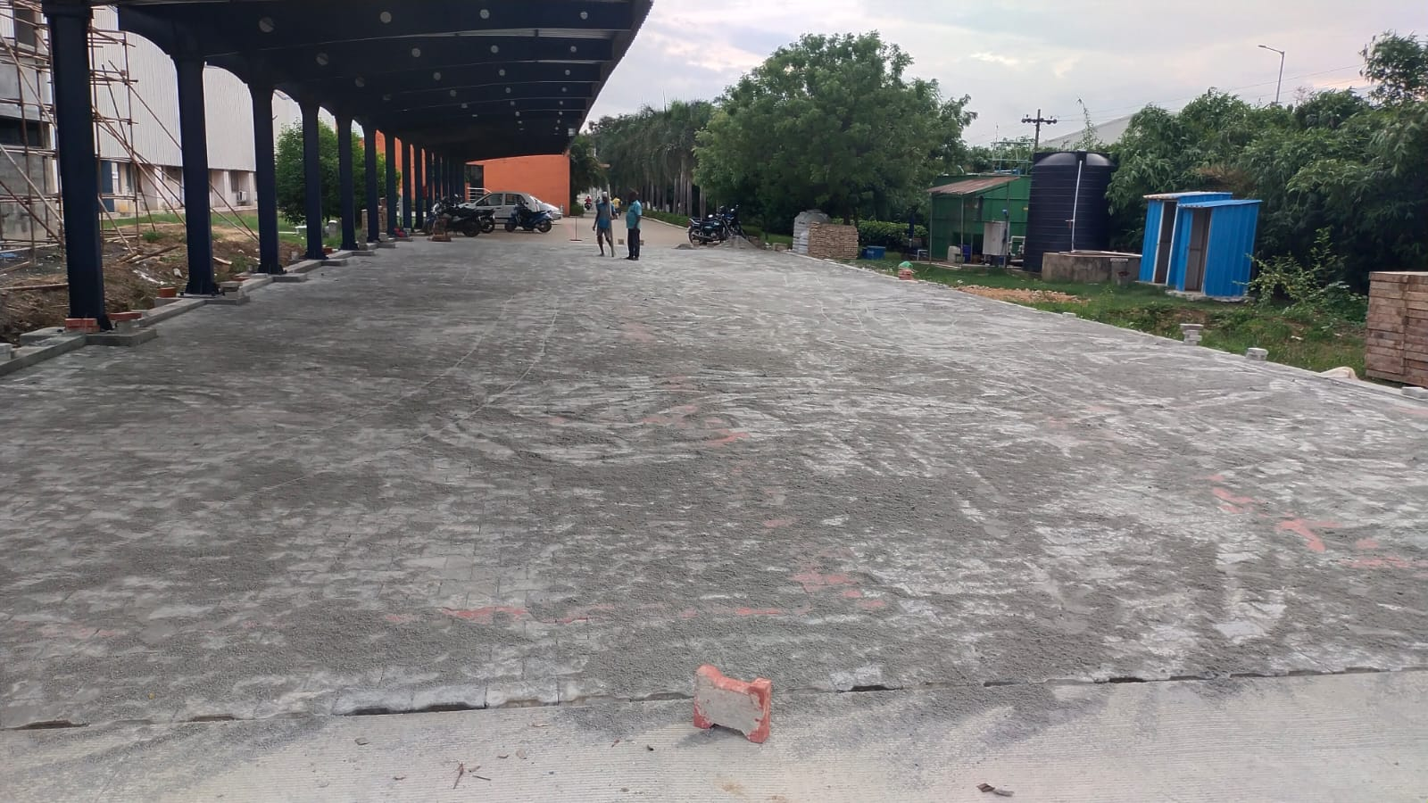


Some of Our Completed Projects
Client : Mipalloy [irungattukottai]
Project : Road, Trench, Fire Hydrant Tank, Veichle Parking & ect.,
Year : 2022
Value : 1.20 Crore [INR]

Slide 18
Our On-Going Project

Slide 19






Our On-Going Project

Slide 20










Our On-Going Projects

Slide 21








Our On-Going Projects

Slide 22




Our On-Going Projects

Slide 23



Our On-Going Projects

Slide 24






Our On-Going Projects

Slide 25






Our On-Going Projects

Slide 26



Our On-Going Projects

Slide 27



Our On-Going Projects
Client : Madras Engineering industries Pvt. Ltd.[Pillaipakkam]
Project : Unit-1 FG Expansion
Year : 2023
Value : 70 Lakh [INR]

Slide 28
Thanks by Team SSS

